Slide 1

Major Project
SHM - SECOND HAND MART
Members:
1606067 Sparsh Sinha
1606306 Siddharth Agrawal
1606373 Rishi Dhacholia

Slide 2

INTRODUCTION
ABOUT THE PROJECT SHM (SECOND HAND MART)
This project is based on an Android Application that can be used for buying second-hand or used products online in a completely secure way. Android Studio is used for creating this application. We used our knowledge of Android development, JAVA, Database Management and its various applications used in android development. E-mail authentication is also used to keep the user’s details secure at all time. All the user’s details like his Name, e-mail id, password along with his transactions are all stored using Realtime Database.

Slide 3


ABOUT ANDROID
Android is a mobile operating system developed by Google. It is based on a modified version of the Linux kernel and other open source software, designed primarily for touchscreen mobile devices such as smartphones and tablets.

Slide 4

ABOUT ANDROID STUDIO
Android Studio is the official integrated development environment for Google's Android operating system, built on JetBrains' IntelliJ IDEA software and designed specifically for Android development. It uses a flexible Gradle-based build system. We have used version 3.6.1 of Android Studio in our project.

Slide 5
REQUIREMENT ANALYSIS
SOFTWARE REQUIRED
HARDWARE REQUIRED
Android Studio
Firebase
XAMPP
Android Studio’s Emulator
HP Pavilion x360 Convertible 14
Samsung Galaxy S8
Samsung Galaxy S20+

Slide 6
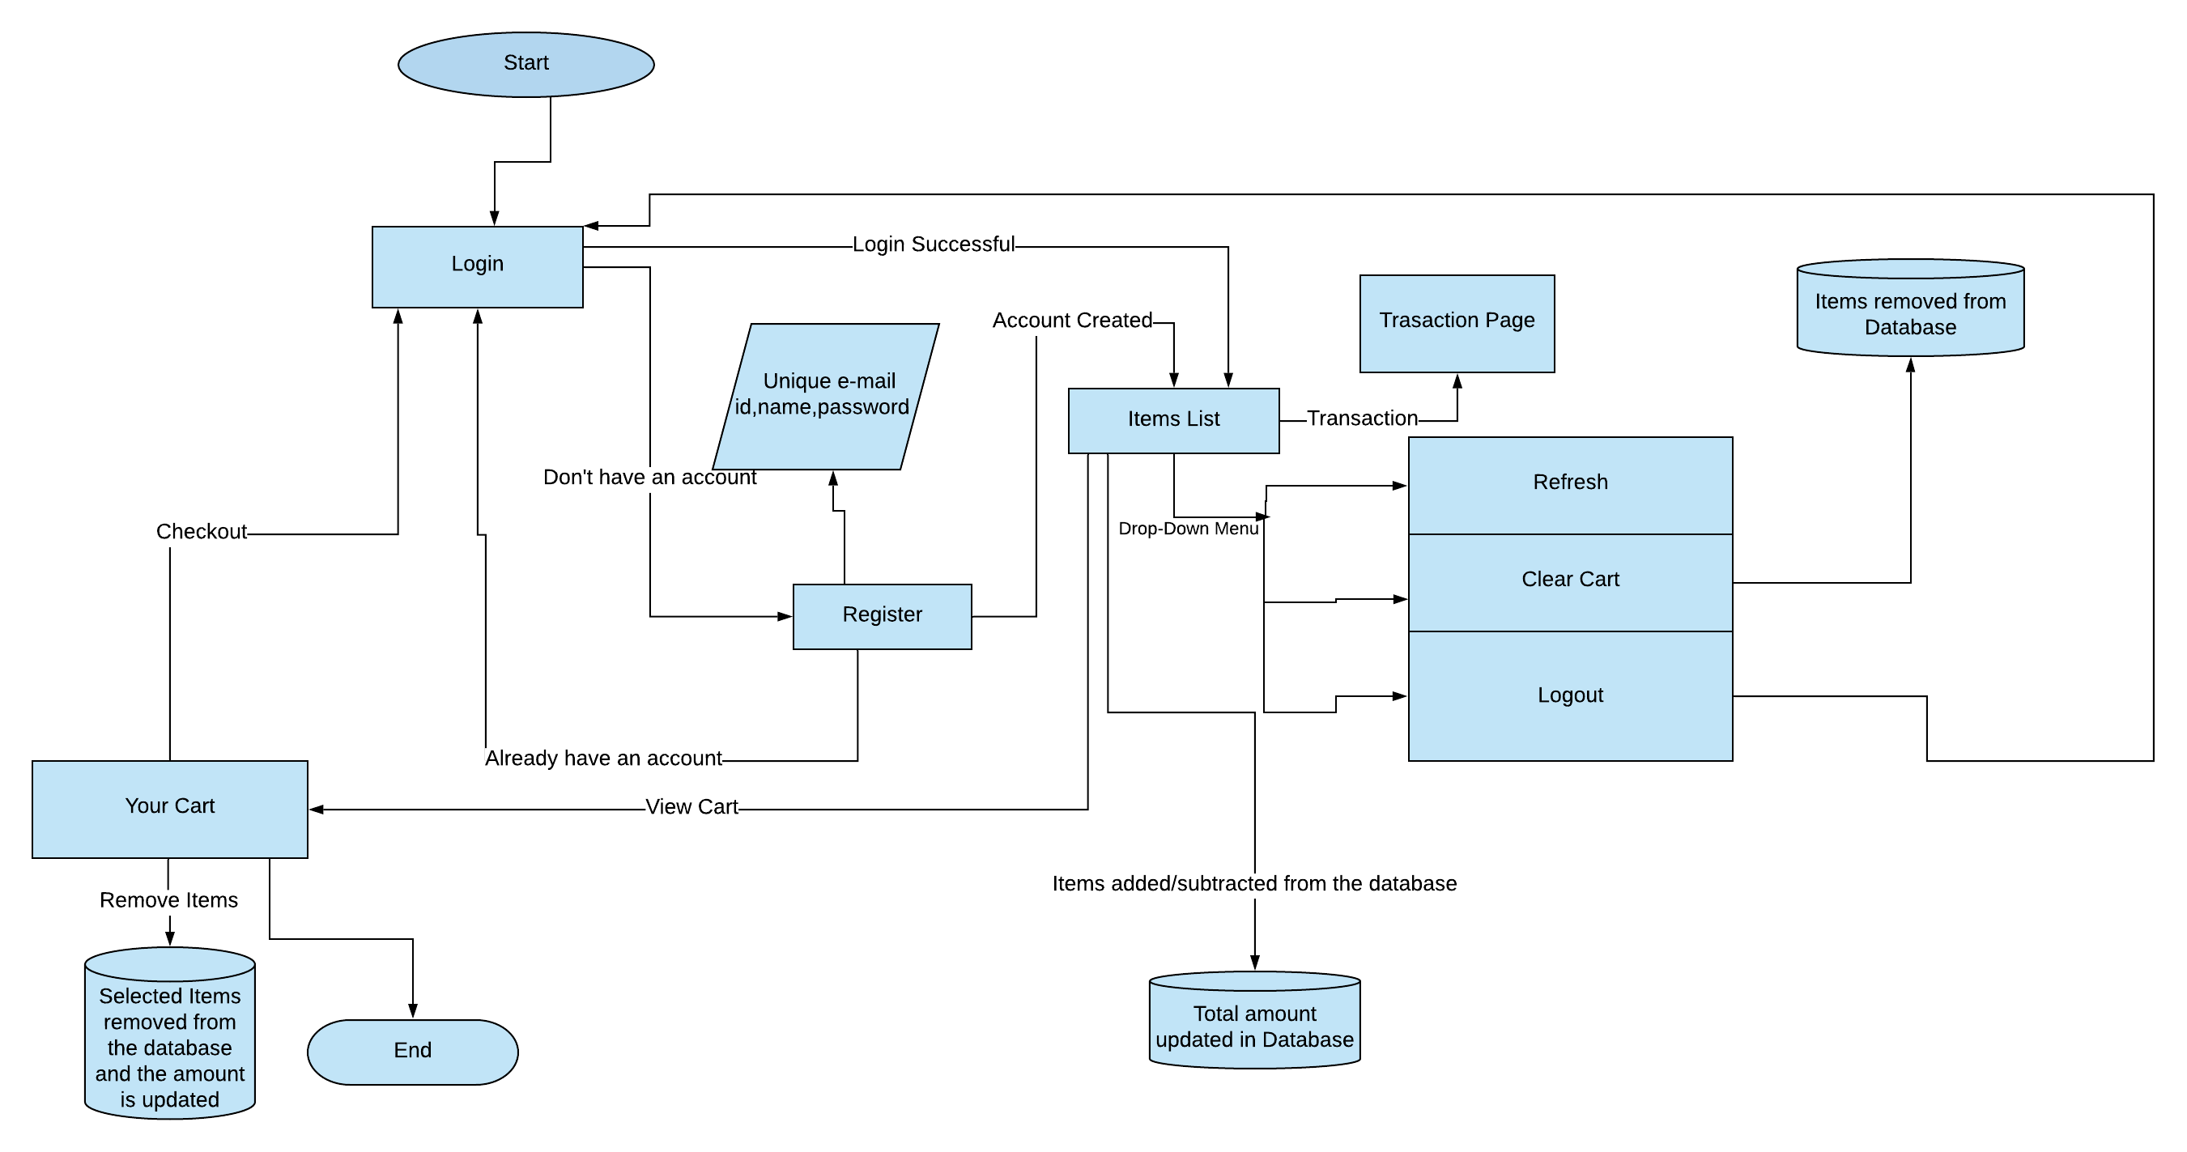
SYSTEM DESIGN

Slide 7
EXPLANATION
Enter the login details (e-mail id, password) in the ‘Login’ page to open the Items list. If the e-mail id and password are correct, only then the user will get to open the ‘Items list’.
If the user hasn’t registered, he/she can do so by going to the ‘Register’ page. There the user details (name, e-mail id, password) are stored in the database.

Slide 8
In the ‘Items list’, there will be multiple options:
Any addition or subtraction of items would update the cart and amount to be paid in the database.
The user can also go and view all the transactions made from his/her account previously.
The user will also get the option to refresh, or to ‘Clear the Cart’, which would delete all the items from the database. He/she can also logout from there, which would take him/her to the ‘Login’ page.
In the ‘Your Cart’ page, the user will have the option to remove one or more of his/her items from the cart, which would remove the selected items from the database and update the amount accordingly.
The ‘Checkout’ button would take the user back to the ‘Login’ page.

Slide 9
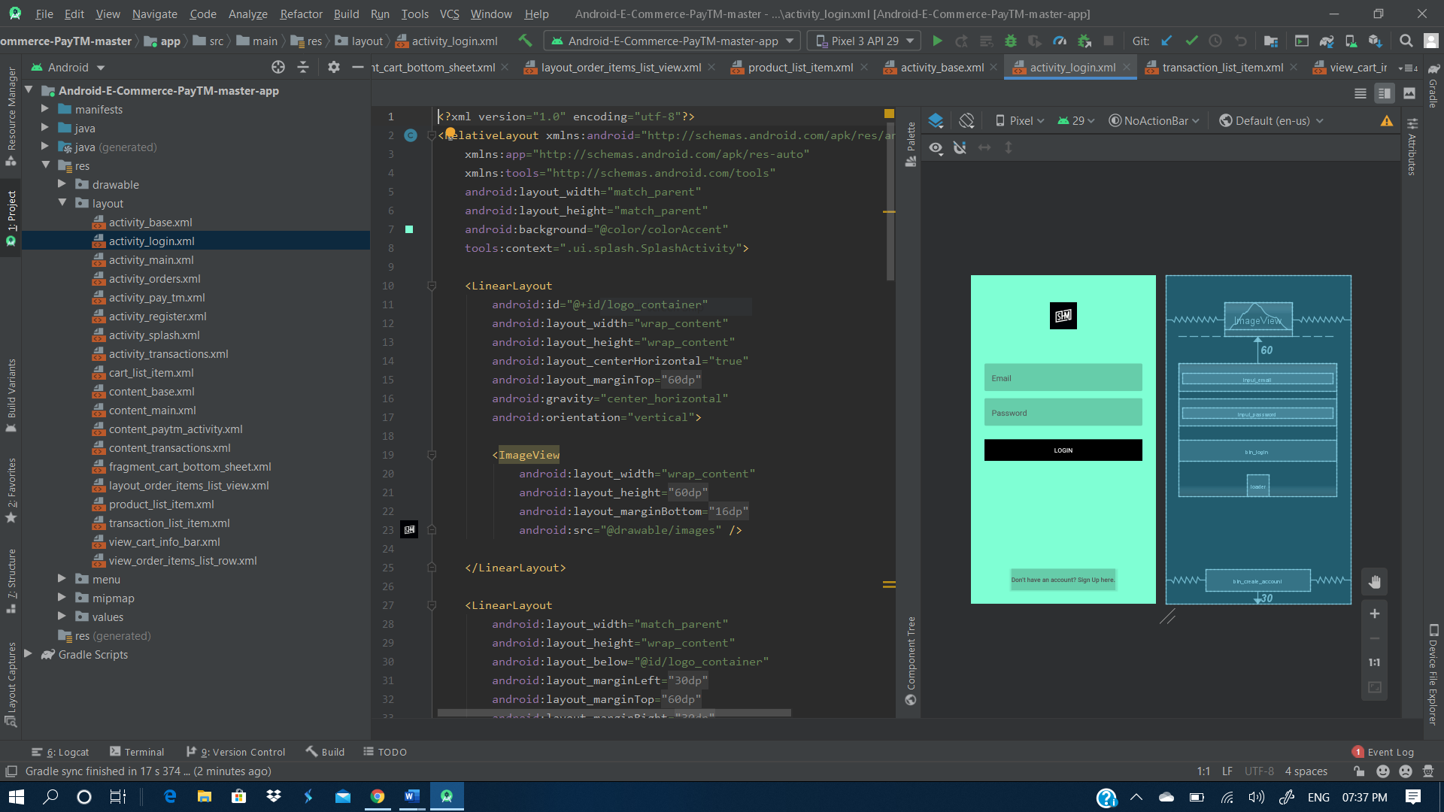
IMPLEMENTATION
The whole project was developed using the Android Studio.
We used Java programming language to generate the source codes for this project along with multiple XML codes for designing the layout of our application.
Multiple of Java classes and XML files were created for the various pages of this application.

Slide 10
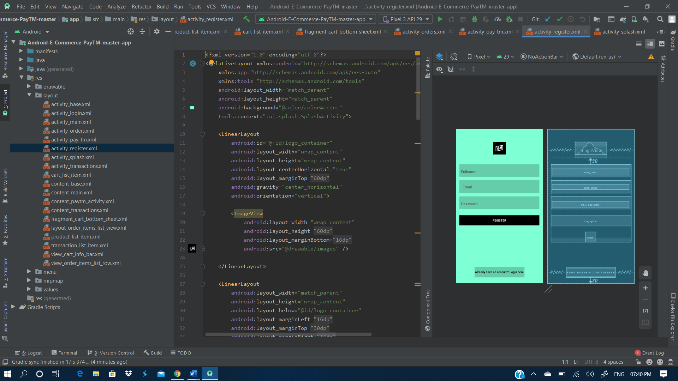
To create the item list, we added the real images taken from e-commerce applications like Flipkart and Amazon.
By adding the ‘+’ and ‘-’ buttons to the item layout, we were able to add the feature of selected one or more of the same product as well.
All these pages were connected using ‘Intent’.

Slide 11
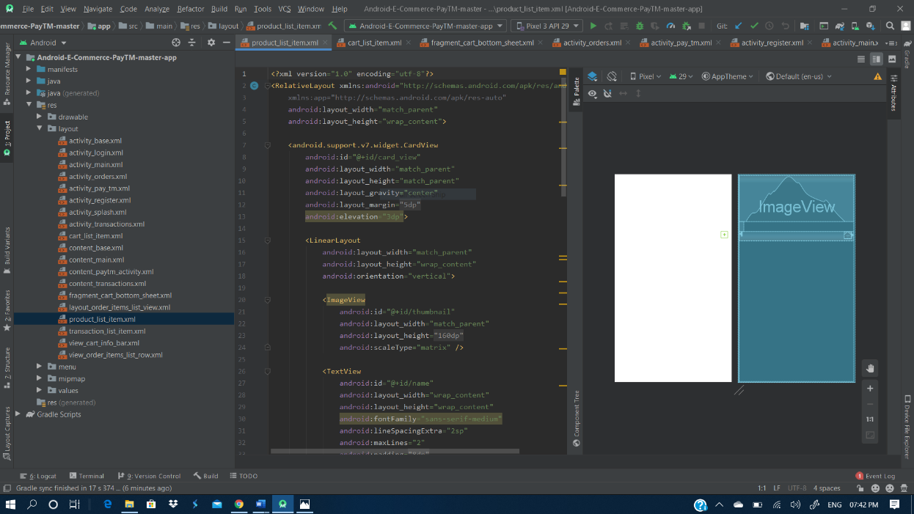
In the main screen, a drop-down menu was added which consists of the 3 points:
Refresh
Clear Cart
Logout
Functioning of all the above mentioned features have been thoroughly discussed in the System Design.
A transaction list was added to this application, that will display the previous transaction being made by the users.
This takes us to the final step of the project- The cart.
The user can view the cart by using the “Checkout” button.

Slide 12
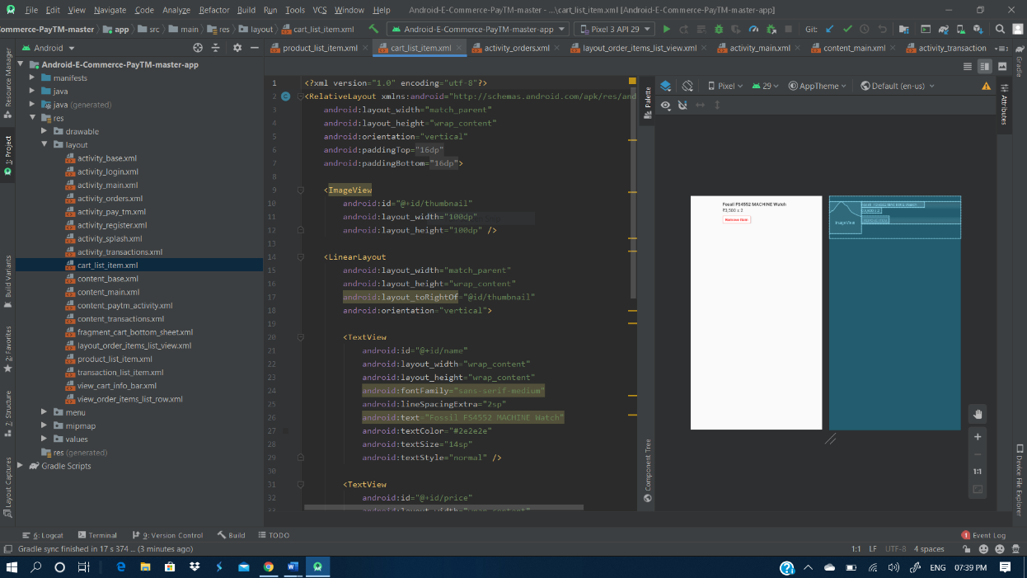
In the cart, we have added the option to Remove Items as well.
By using the ‘Remove Item’ button, the user can completely remove the selected item from the cart.
The selected button would hence be deleted from the database along with the amount of the item being subtracted from the total amount.
Without the payment option, Checkout would be the last step of this project.

Slide 13
MANIFEST
<uses-permission android:name="android.permission.INTERNET" />
<uses-permission android:name="android.permission.ACCESS_NETWORK_STATE" />
<application
android:name=".app.MyApplication"
android:allowBackup="true"
android:icon="@mipmap/images"
android:label="Second Hand Mart"
android:roundIcon="@mipmap/images"
android:supportsRtl="true"
android:theme="@style/AppTheme">
<activity
android:name=".ui.transactions.TransactionsActivity"
android:label="@string/title_activity_transactions"
android:screenOrientation="portrait"
android:theme="@style/AppTheme.NoActionBar" />

Slide 14
<activity
android:name=".ui.splash.SplashActivity"
android:screenOrientation="portrait"
android:theme="@style/AppTheme.NoActionBar">
<intent-filter>
<action android:name="android.intent.action.MAIN" />
<category android:name="android.intent.category.LAUNCHER" />
</intent-filter>
</activity>
<activity
android:name=".ui.main.MainActivity"
android:label="@string/app_name"
android:screenOrientation="portrait"
android:theme="@style/AppTheme.NoActionBar"></activity>
<activity
android:name=".ui.login.LoginActivity"
android:screenOrientation="portrait"
android:theme="@style/AppTheme.NoActionBar" />
<activity
android:name=".ui.register.RegisterActivity"
android:screenOrientation="portrait"
android:theme="@style/AppTheme.NoActionBar" />
</application>

Slide 15
SYSTEM TESTING
Test ID | Test Case Title | Test Condition | System Behaviour | Expected Result
T01 | User Login Test- I | The correct E-mail id and password entered | Login successful and the Items list is opened. | A successful login and the Items list expected to open.
T02 | User Login Test- II | Invalid E-mail address entered | Login unsuccessful. | Unsuccessful login.
T03 | User Login Test- III | A valid E-mail address entered with a wrong password | Login unsuccessful. | Unsuccessful login.
T04 | Registration Test- I | A valid and unused E-mail id is entered | Account created. | Creation of new Account.
T05 | Registration Test- II | An already Active E-mail id is entered | Registration failed. | Failure in new account creation.
T06 | Items Test | Addition/Subtraction of items | Cart and Amount updated. | Changes in cart and amount.
T07 | Clear Cart Test | Clear Cart option was selected | All items were removed from cart. | Removal of items from the cart.
T08 | Logout Test | Logout option was selected | User taken back to the Login page. | Login page was expected to open.
T09 | Removal Test | Press Remove Items | All items removed. | Removal of items.
T10 | Checkout Test | The Checkout button was pressed. | User taken back to the Login page. | Login page was expected to open.

Slide 16
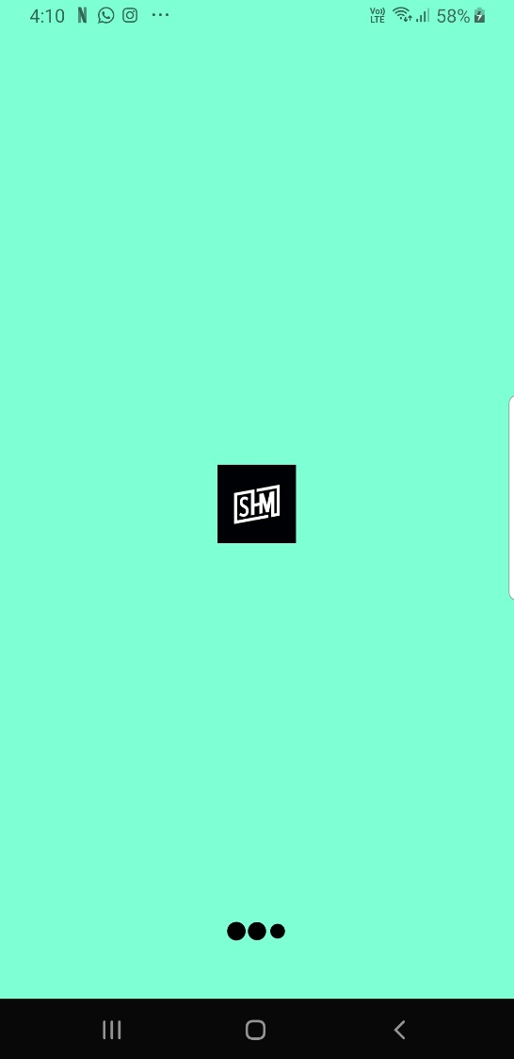
SCREEN SHOTS OF THE WORKING APPLICATION
APPLICATION SPLASH SCREEN:

Slide 17
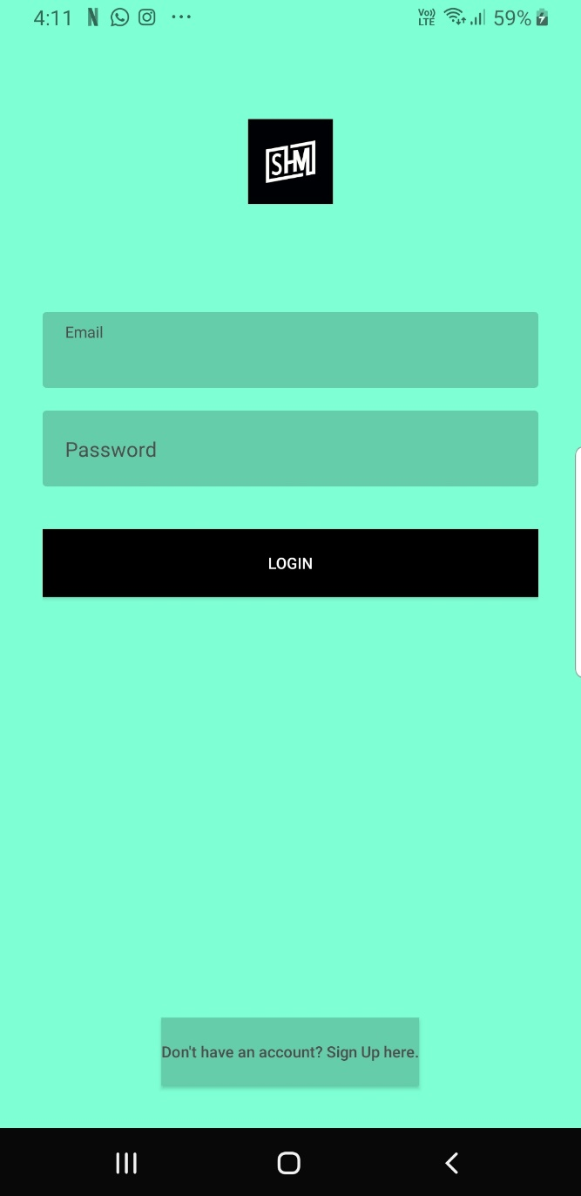
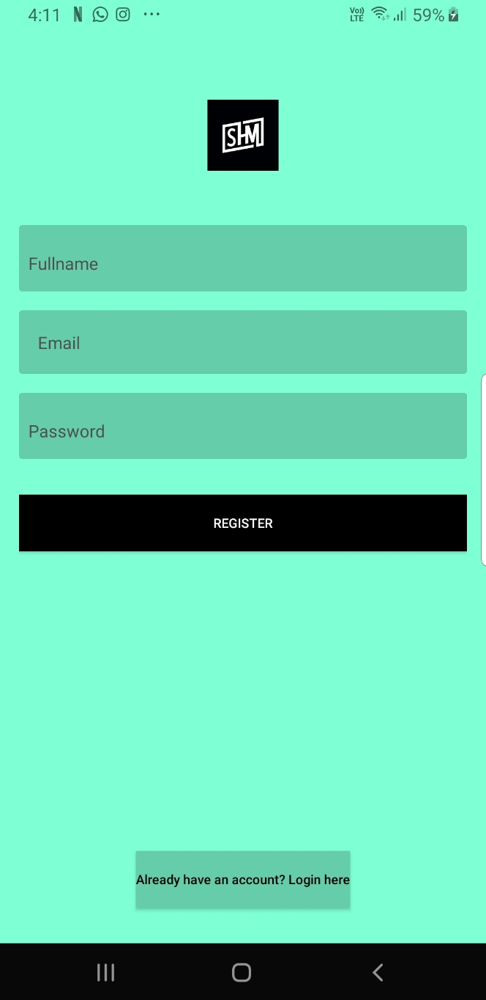
LOGIN PAGE:
REGISTRATION PAGE:

Slide 18
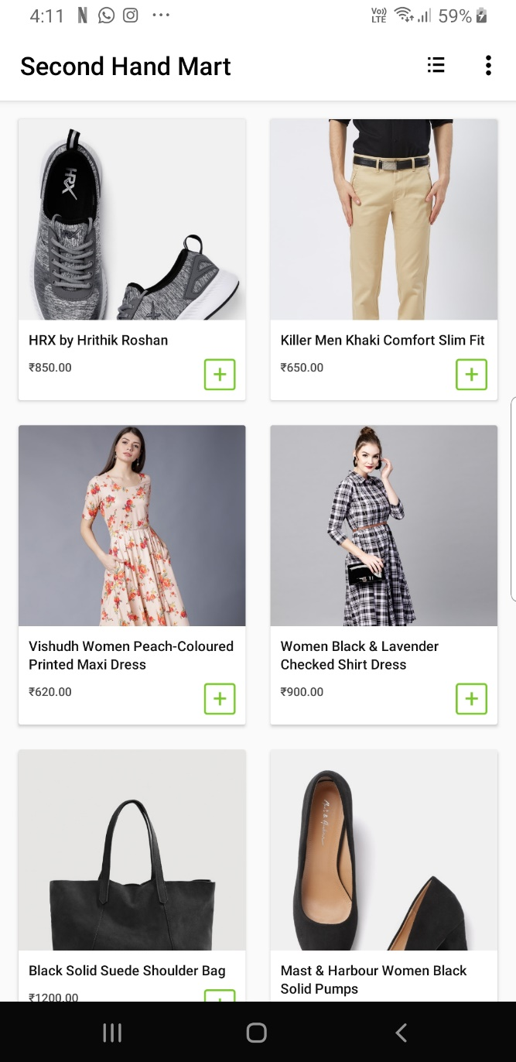
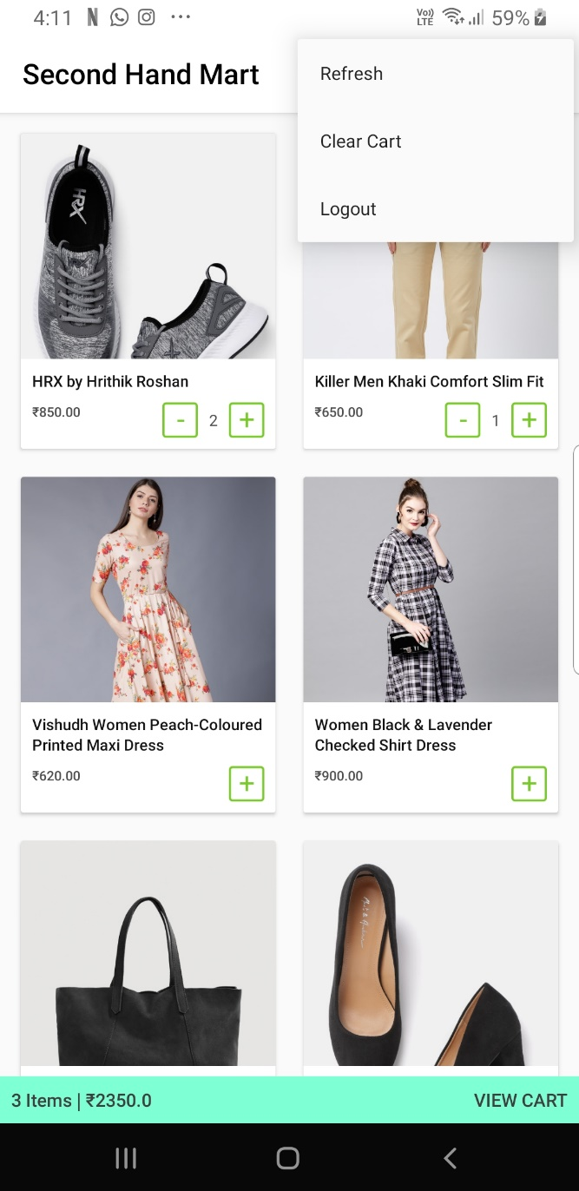
SHOPPING ITEMS:
DROPDOWN MENU:

Slide 19
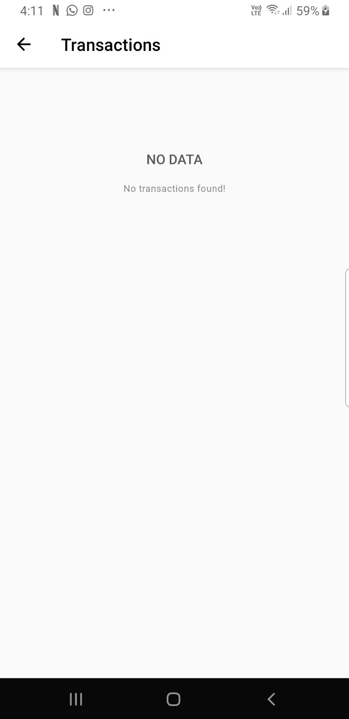
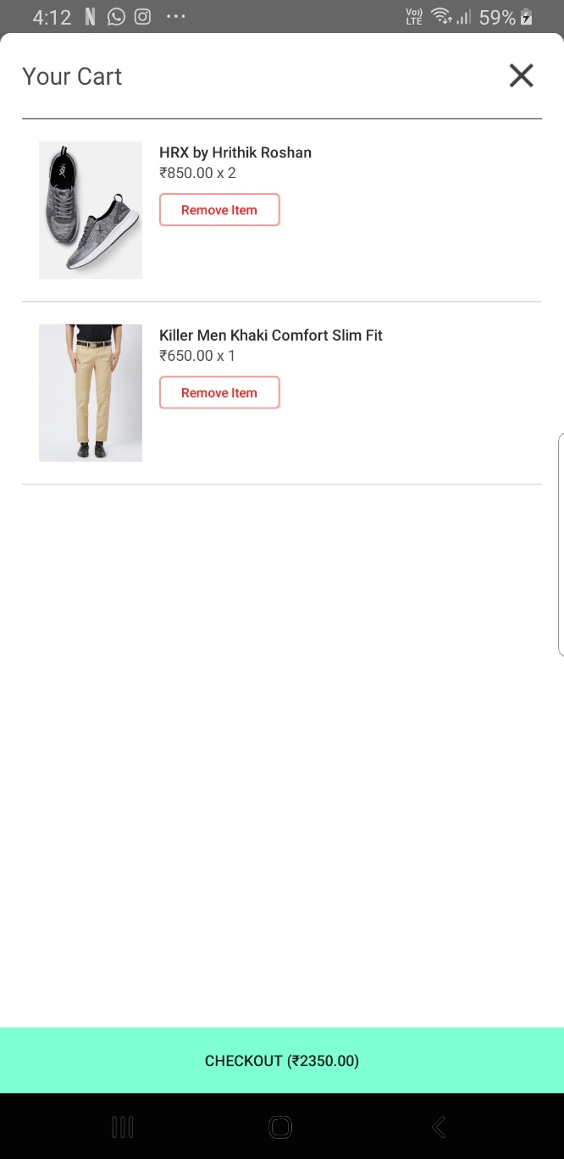
PREVIOUS TRANSACTIONS PAGE:
CART WITH CHECKOUT BUTTON:

Slide 20
CONCLUSION
In this project, we developed an Android Application that can be used for buying “second-hand” products online implementing the things we learned in our theoretical and lab sessions along with the concepts we got familiar with in our trainings and internships. We used Realtime Database for saving user and product details, as well as the transactions that a user has made. Along with this, we have added E-mail authentication to keep the application secure.
We used Android Studio 3.6.1 for creating out application. We got the chance to use our knowledge of Android development, JAVA, Database Management and its various applications used in android development. This project also helped us in learning about new things like Splash Screen and how to use the MySQL Database in Android Studio.

Slide 21
FUTURE SCOPE
There is a lot of future scope in this project. Some of them are as follows:
Under a proper authorization, different payment methods like Cash on Delivery, Credit & Debit cards, Wallets and UPI can be implemented to this application.
Many new features can be added to this project like:
•Search option
•Customer Support Service
•Order Cancellation Option
Using this as a base application, different categories of products can be added to establish this application up to a wider range of customers.

Slide 22
THANK YOU

